Slide 1

NTAs and public policy in
Latin America and the Caribbean
Simone Cecchini
Director
CELADE – Population Division
Economic Commission for Latin America and the Caribbean (ECLAC)
Panel on NTA and public policy, 14 February 2023
Building Sustainable Generational Economies: The 14th Global Meeting of the NTA Network
University of Paris - Dauphine

Slide 2
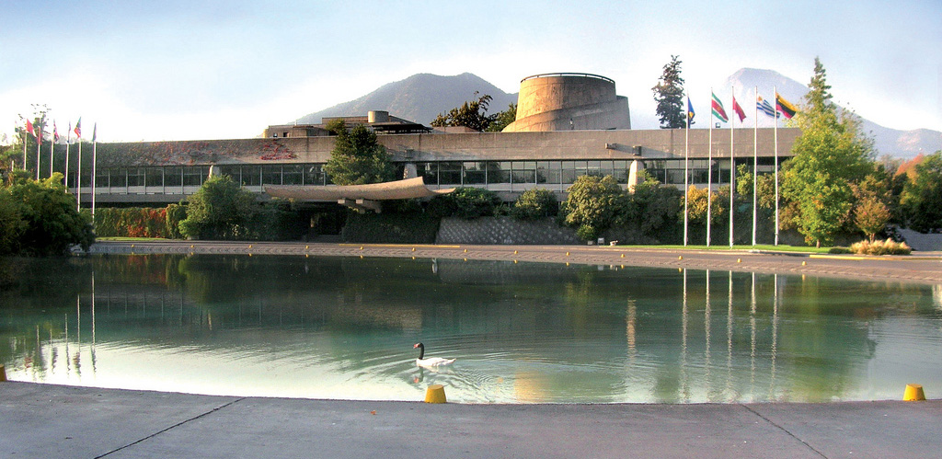
ECLAC's mission: promote the sustainable development of Latin America and the Caribbean
United Nations Regional Commission, funded in 1948.
Headquarters in Chile; Subregional HQs in Mexico, Trinidad and Tobago.
Comprehensive analysis of development processes.
Formulation, monitoring and evaluation of public policies.
Specialized information, advice, training and support for regional and international cooperation and coordination.
The Latin American and Caribbean Centre for Demography (CELADE) – Population Division of the ECLAC has promoted the production and use of National Transfer Accounts (NTAs).

Slide 3

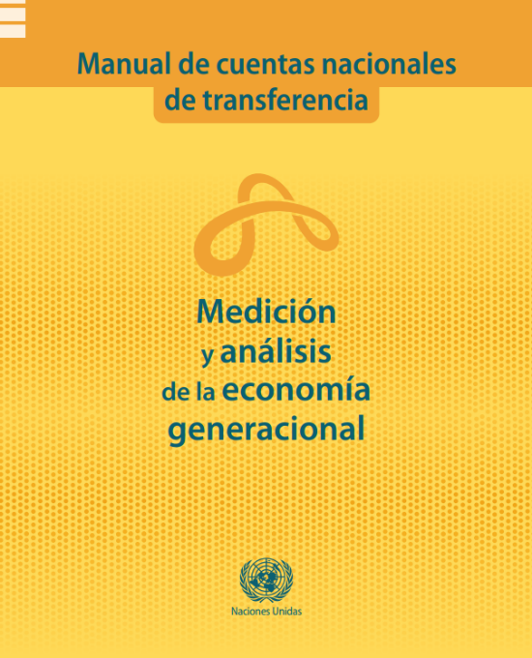
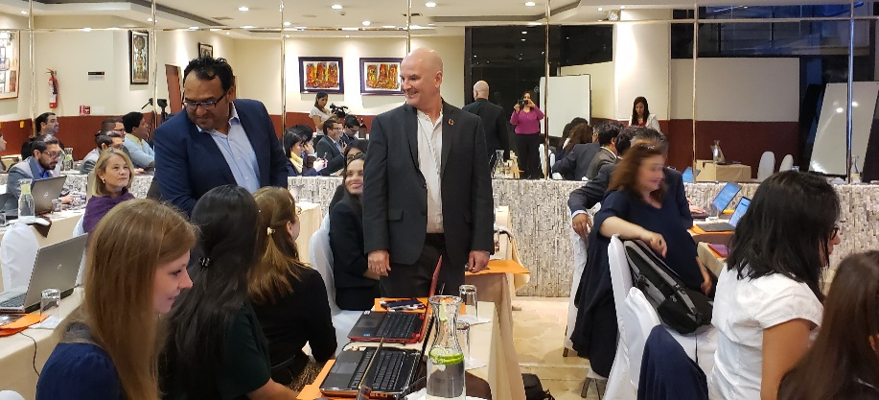
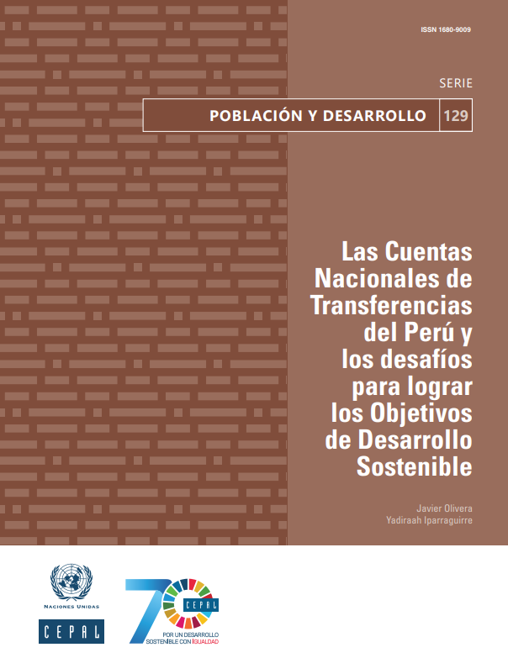
Past NTA-related projects at the ECLAC
Intergenerational transfers, population ageing and social
protection in Latin America (2007-2009), financed by IDRC: 9 target countries.
Demographic transition: Opportunities and challenges to achieve the SDGs in LAC (2017-2019), financed by the UN Development Account: 12 target countries.
Spanish edition of the National Transfer Accounts Manual (2022), with DESA.

Slide 4
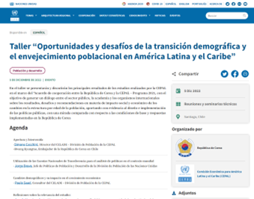

NTA-related projects at the ECLAC: present and future
Development impacts of the demographic transition, financed by the Republic of Korea (2022-2023); regional/comparative focus.
Inclusive and sustainable economic growth in a society for all ages in the post-COVID-19 era in Asia and LAC (2023-2025), with DESA and ESCAP, financed by UN D.A; 4 target countries: Colombia, Costa Rica, Jamaica, and Uruguay.

Slide 5
Relevance of NTAs for public policies in Latin America and the Caribbean (LAC)
Context characterized by high inequalities, informality and rapid population ageing: share of over 60 will go from 13.4% in 2022 to 25.1% in 2050.
NTAs contribute to the design of forward-looking policies, which take demographic change into account.
Quantify income, consumption, dependency, transfers and assets along the life cycle.
Quantify the effects of ageing on public pension transfers, health and education expenditures.
Provide information to analyze the extent to which social protection systems are able to guarantee basic rights through the different stages of life.
Focus on poverty/inequality (NIA) and gender/care (NTTA) is key in LAC.

Slide 6
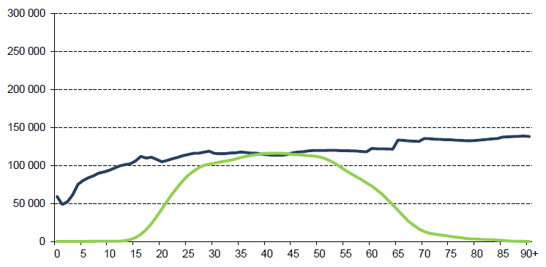
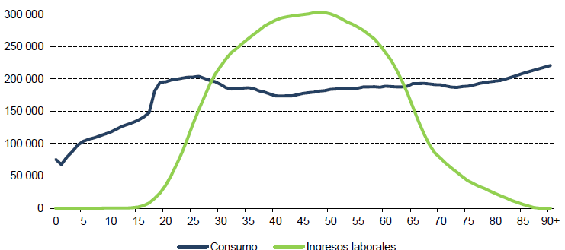
In the lowest socioeconomic groups, there is no surplus
ARGENTINA: PER CAPITA CONSUMPTION AND LABOUR INCOME BY SOCIOECONOMIC GROUP, 2016
(Argentine Pesos)
GROUP 1 (HOUSEHOLD HEAD ≤ 7 YEARS OF EDUCATION)
GROUP 3 (HOUSEHOLD HEAD ≥ 13 YEARS OF EDUCATION)
Consumption
Labour income
Consumption
Labour income
Source: Comelatto (2020), “Transferencias entre generaciones y grupos socioeconómicos: estimaciones de las Cuentas Nacionales de Transferencias en la Argentina”, serie Población y Desarrollo, N° 128 (LC/TS.2019/105), Santiago, Comisión Económica para América Latina y el Caribe (CEPAL).

Slide 7



Access to consumption by children and older persons
CHILDREN | OLDER PERSONS
PRIVATE TRANSFERS from their families (housing, food, clothing) | Private transfers from their families (housing, food, clothing).
 | Many are also providers of support.
PUBLIC TRANSFERS | Public transfers ().
Child / family allowances, education, health. In 2018, in Latin America 33% of HHs with children did not receive any public cash transfer | Pensions, healthcare. In 2020, in Latin America 40% of people aged 65 and over received no pension or pensions worth less than one poverty line.
LABOUR INCOME
Child labour: in 2016, 7.3% of children aged 5-17 in LAC. | Remain in the labour market / income generating activities. About 1/3 of people aged 60 and above is occupied.
 | ASSETS accumulated previously

Slide 8
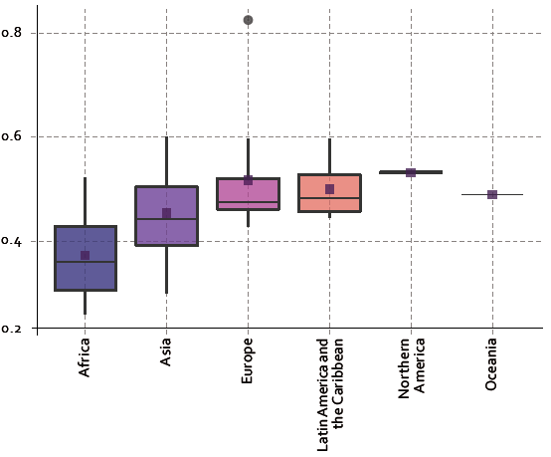
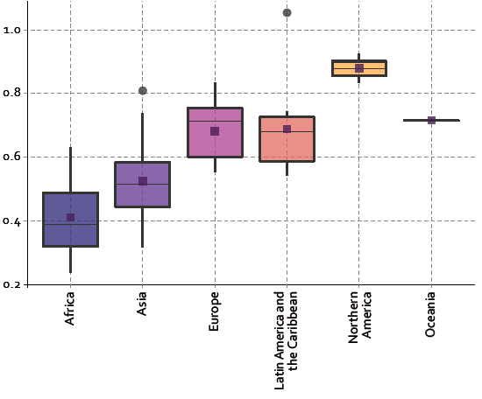
In LAC, life cycle deficit at ages 0-19 is among the highest in the world.
The deficit at older ages is a more significant fraction of labour income
WORLD REGIONS: LIFE CYCLE DEFICIT (LCD) (AGES 0–19) / LABOUR INCOME (YL) (AGES 30–49)
WORLD REGIONS: LIFE CYCLE DEFICIT (LCD) (65+) /
LABOUR INCOME (YL) (AGES 30–49)
Source: Turra and Fernandes (2020), “Demographic transition: opportunities and challenges to achieve the Sustainable Development Goals in Latin America and the Caribbean”, Project Documents, (LC/TS.2020/105), Santiago, Economic Commission for Latin America and the Caribbean (ECLAC).

Slide 9
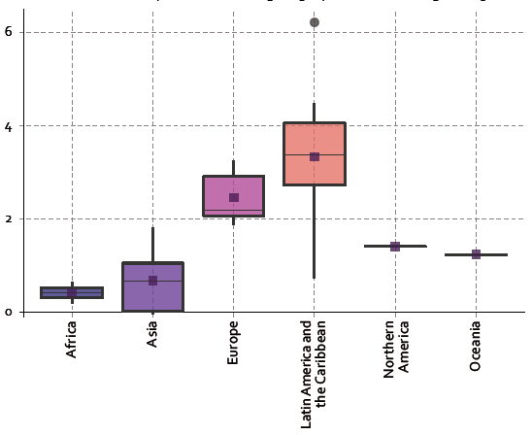
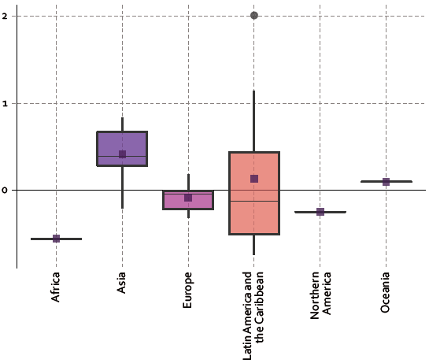
Insufficient public transfers in LAC are skewed towards the elderly. Private transfers play a minor role in supporting older people
WORLD REGIONS: PUBLIC TRANSFERS (TG) (AGES 65+) /
PUBLIC TRANSFERS (TG) (AGES 0-19)
WORLD REGIONS: PRIVATE TRANSFERS (TG) (AGES 65+) /
PRIVATE TRANSFERS (TG) (AGES 0-19)
Source: Turra and Fernandes (2020), “Demographic transition: opportunities and challenges to achieve the Sustainable Development Goals in Latin America and the Caribbean”, Project Documents, (LC/TS.2020/105), Santiago, Economic Commission for Latin America and the Caribbean (ECLAC).

Slide 10
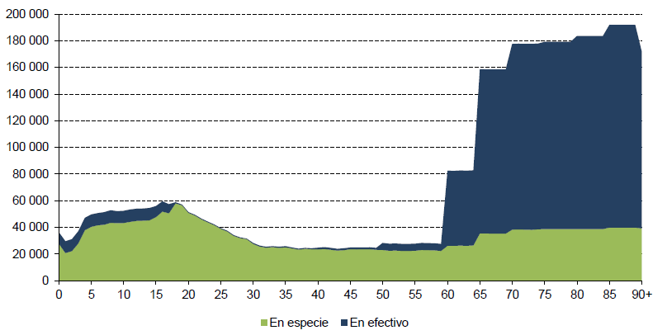
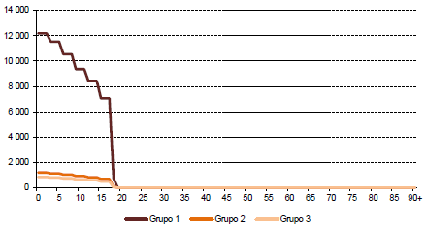
Measuring intergenerational transfer systems helps to rethink social protection systems
ARGENTINA: PER CAPITA INFLOWS, PUBLIC TRANSFERS FOR CHILDREN (AUH), 2016
(Argentine Pesos)
ARGENTINA: PER CAPITA INFLOWS, PUBLIC TRANSFERS, 2016
(Argentine Pesos)
In-kind
Cash
Group 1
Group 2
Group 3
Source: Comelatto (2020), “Transferencias entre generaciones y grupos socioeconómicos: estimaciones de las Cuentas Nacionales de Transferencias en la Argentina”, serie Población y Desarrollo, N° 128 (LC/TS.2019/105), Santiago, Comisión Económica para América Latina y el Caribe (CEPAL).

